Slide 1


LARGE-SCALE PDF ANALYSIS LEVERAGING RAG AND LLMS FOR ENHANCED ML LITERATURE INSIGHTS
TEAM 8 - DIVYA NEELAMEGAM, POOJITHA VENKATRAM, SHRUTI BADRINARAYANAN, SOURABH SURESH KUMAR
SAN JOSÉ STATE UNIVERSITY
DEPARTMENT OF APPLIED DATA SCIENCE
DR. SIMON SHIM
DEC 07, 2024

Slide 2

ACKNOWLEDGEMENT

Slide 3
We would like to express our sincere gratitude to
Dr. Simon Shim for his invaluable guidance and support throughout this project.
We also extend our appreciation to our team members for their collaboration and dedication in bringing this project to fruition. Lastly, we acknowledge the contributions of the research community and the resources provided by databases such as Arxiv and the Journal of Machine Learning Research, which were essential for our work.

Slide 4
INTRODUCTION

Slide 5



MOTIVATION, BACKGROUND & NEEDS
ML & AI: Rapidly advancing domain/fields with continuous research and breakthroughs
Researchers, students, and professionals struggle to stay updated with latest developments
ML research literature often involves complex concepts and advanced mathematical formulas
Conventional literature review processes are time-consuming and inefficient
Need: Tools to simplify accessibility and comprehension of ML and AI literature
OBJECTIVES & DELIVERABLES
Develop a chat application using RAG techniques and LLMs to interpret research paper PDFs
Parse non-text content in PDFs (multimodal content)
Provide informed responses to technical questions using a database of 25000+ research papers (arXiv and JMLR)
Create an efficient ML/AI Research Paper Search Engine
Identify optimal RAG components for effective performance

Slide 6
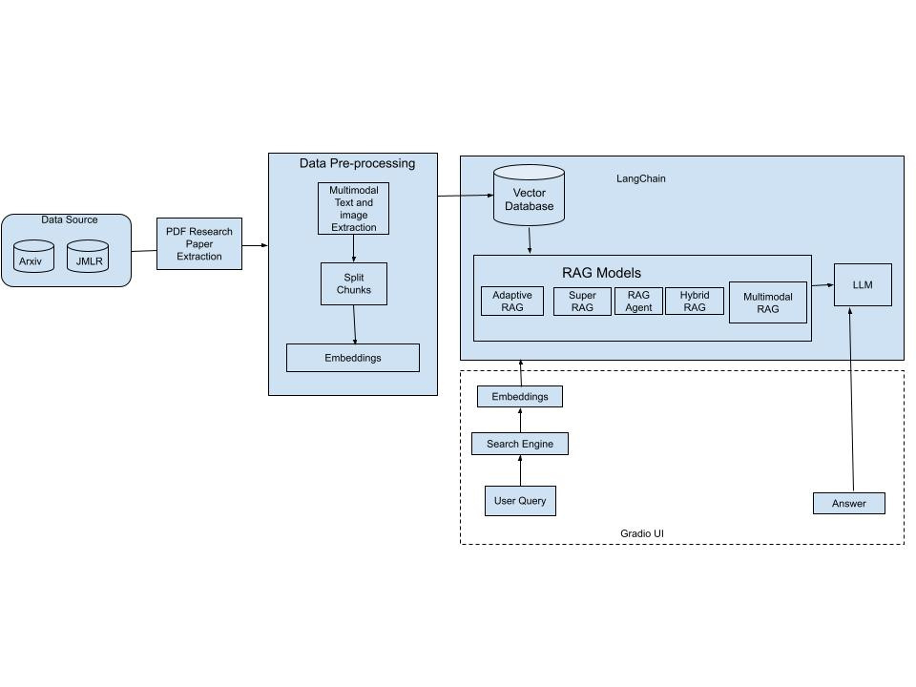
PROPOSED SYSTEM ARCHITECHURE

Slide 7
TECHNOLOGY AND LITERATURE SURVEY

Slide 8
TECHNOLOGY & SOLUTION SURVEY
UNDERSTANDING THE COMPETITIVE LANDSCAPE
Solution | Description | Technologies & Approaches | Strengths
Semantic Scholar | AI-powered scientific search engine | Semantic search, knowledge graphs, citation analysis | Concept-based search, author profiles, visualizations
Typeset / SciSpace | PDF analysis, scientific paper search, summarization | PDF processing with custom tools/OCR, possibly some semantic search, potentially limited LLM integration | Direct competitor in the space
Elicit | Research tools using LLMs to extract insights from papers | Focus on LLM for question-answering, likely on pre-specified papers | Potential for in-depth answers
Continuously Evolving Space and Domains - LLMs, LlaMa-3, OpenAI, Claude, Gemini and more.
Consider Costs & Feasibility.

Slide 9
TECHNOLOGY & SOLUTION SURVEY
FEATURE COMPARISON: OUR VISION
Feature | Semantic Scholar | Typeset / SciSpace | Elicit | Haystack | Our Project (Potential)
Scientific Paper Search | ✓ | ✓ | Limited | Customizable | ✓ (Must be robust)
PDF Upload & Processing | Limited | ✓ | – | Customizable | ✓ (Thorough & Accurate)
PDF Question-Answering | Limited | Potentially Limited | ✓ | Highly Customizable | Aim for advanced LLM-RAG (Scientifically Rigorous)
Summarization | ✓ | ✓ | ✓ | Customizable | ✓ (High-Quality & Domain-Specific)

Slide 10


LITERATURE SURVEY
Study Details | Data Used | Algorithms/Methods Used | Important Takeaways
Retrieval-Augmented Generation for Large Language Models: A Survey | 50 datasets | The paper categorizes RAG systems into three paradigms—Naive RAG, Advanced RAG, and Modular RAG for handling information retrieval and integration. | Provides an extensive overview of the advances in Retrieval-Augmented Generation (RAG) systems, which enhance the capabilities of large language models (LLMs) by integrating external data retrieval into the generative process.
Automating Information Retrieval from Faculty Guidelines: Designing a PDF-Driven Chatbot powered by OpenAI ChatGPT | Panduan-P2M-LPPM-UNS-Edisi-IX-Tahun-2022 as dataset | ChatGPT 3.5 Turbo LangChain Pinecone | Discusses the design of a chatbot for automating information retrieval from PDF faculty guidelines.
Improving the Domain Adaptation of Retrieval Augmented Generation (RAG) Models for Open Domain Question Answering | Various open-domain QA datasets | RAG-end2end due to its excellent open-source documentation and availability. | Focuses on domain adaptation techniques for RAG models, aiming to enhance performance in open-domain QA tasks.
A Survey of Large Language Models | BookCorpus, CommonCrawl, Reddit Links, Wikipedia | Pre-training, adaptation tuning, utilization, and capacity evaluation. | Provides a comprehensive survey of the development, capabilities, and challenges of large language models.

Slide 11
LITERATURE SURVEY
Study Details | Data Used | Algorithms/Methods Used | Important Takeaways
Adaptive-RAG: Learning to Adapt Retrieval-Augmented Large Language Models through Question Complexity (March 2024) | Single-hop and Multi-hop QA datasets | Adaptive Retrieval-Augmented Generation (RAG) - Question complexity-based adaptive retrieval strategy - Hybrid approach for single-hop and multi-hop QA tasks | Dynamically adjusts retrieval strategies based on question complexity. - Improves retrieval efficiency and response accuracy. - Significant gains in multi-hop reasoning tasks.
Corrective Retrieval Augmented Generation (Oct 2024) | PopQA (short-form), Biography (long-form), PubHealth (true-or-false), Arc-Challenge (multiple-choice) | Corrective RAG Framework - Retrieval feedback loops for iterative improvement - Attention-based correction and refinement mechanisms | Enhances model reliability via corrective feedback during generation. - Ensures factual consistency in outputs by addressing retrieval inaccuracies. - Robust performance across short-form, long-form, and reasoning tasks.
Self-RAG: Learning to Retrieve, Generate, and Critique through Self-Reflection (Oct 2023) | PubHealth, ARC-Challenge (multiple-choice reasoning dataset), PopQA (short-form, open-domain question answering), TriviaQA-unfiltered (open-domain question answering), Biography Generation (long-form generation), ALCE-ASQA | Self-Reflection RAG (Self-RAG) - Feedback-driven retrieval and critique mechanisms - Zero-shot evaluation with task-specific instructions | Introduces self-reflection for critiquing and refining outputs. - Evaluates correctness, factuality, and fluency. - High retrieval accuracy and quality improvements in fact verification, reasoning, and QA tasks.

Slide 12
DATA ENGINEERING

Slide 13
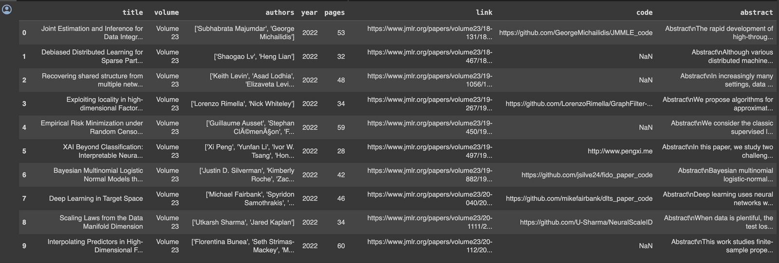
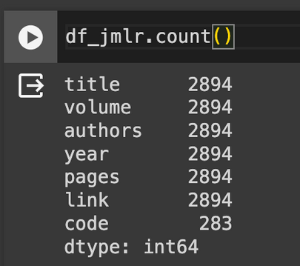
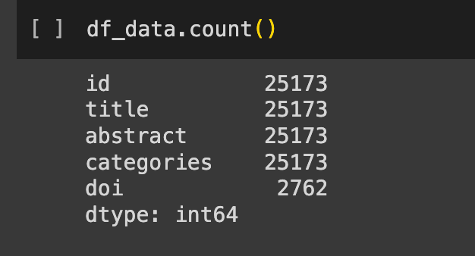
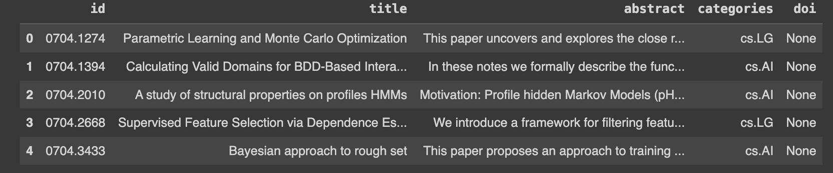
DATA COLLECTION
JMLR DATASET:
ARXIV DATASET:

Slide 14
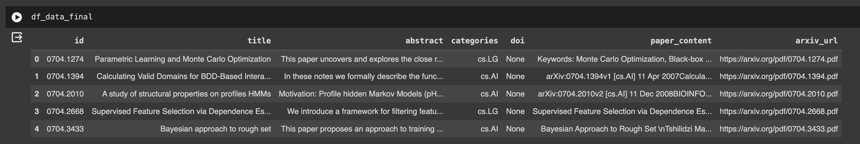
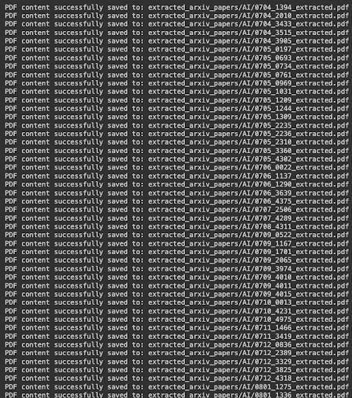
Extracted pdfs using the url,
DATA PRE-PROCESSING
Initial filtering targeted the selection of documents relevant to the fields of Machine Learning (ML) and Artificial Intelligence (AI) by extracting records where the 'categories' attribute was marked as "cs.AI" or "cs.LG" from the arXiv dataset.
To facilitate the extraction of the actual papers, the arXiv URL is composed using the unique identifiers in the dataset, forming links such as "https://arxiv.org/pdf/<id>.pdf"
Papers that had been withdrawn or inaccessible were identified and excluded from the dataset to maintain its integrity.
Integrates seamlessly with visual captioning techniques powered by Llama3, pytesseract, and the Unstructured API to further enhance the extraction of textual data embedded within images, such as table headers or annotations.

Slide 15
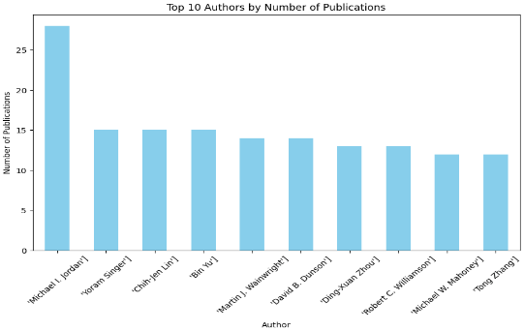
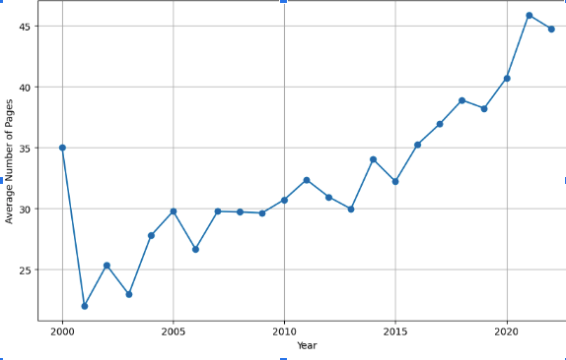
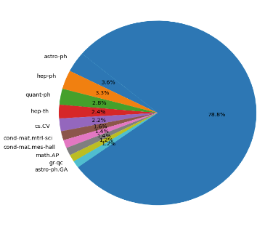
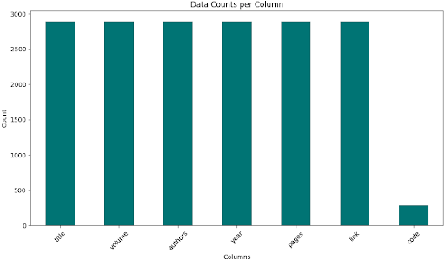
DATA STATISTICS

Slide 16
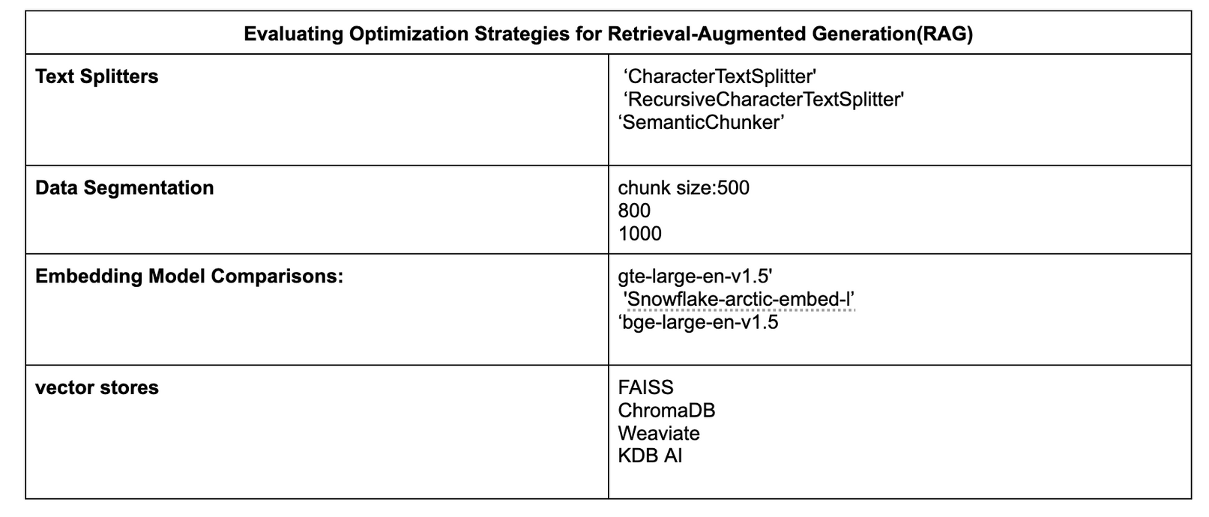
EVALUATING OPTIMIZATION STRATEGIES FOR RETRIEVAL-AUGMENTED GENERATION(RAG) AND MAIN VECTOR DATABASE CORPUS
Text Splitters: RecursiveCharacterTextSplitter' performs better
Data Segmentation: the model performs better with chunk size of 500
Embedding Model Comparisons: gte-large-en-v1.5' embedding model performs better
Vector Database: FAISS and ChromaDB performs better

Slide 17
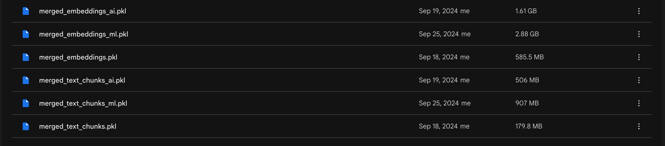
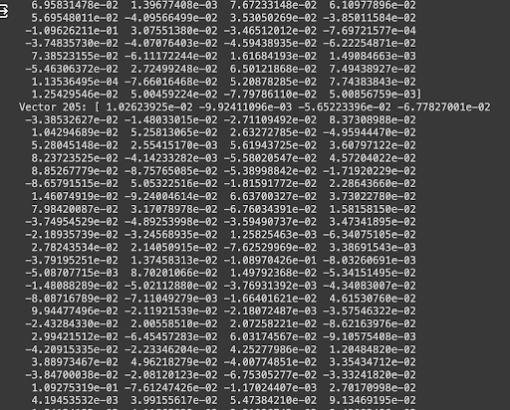
MAIN VECTOR DATABASE

Slide 18
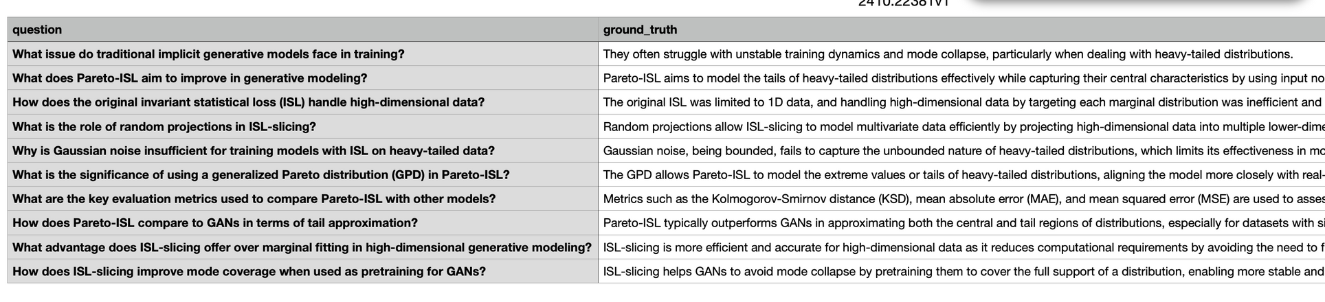
DATA TRAINING AND VALIDATION
The data is split into an 80/10/10 ratio, and the train pdfs are used to train our main corpus of data.
The validation dataset is used for testing the performance of the model by manually creating the questions, ground_truth and compared with the RAG_Answers for validation.

Slide 19
MODELING

Slide 20
​​​​M1: LLAMA 3 WITH ENSEMBLE RETRIEVAL FOR HYBRID RAG FRAMEWORK (BASELINE MODEL)
Approach
Document Processing: Scientific publications are processed using PyPDFLoader, converting PDF pages into text, which is then chunked into contextually rich segments with the RecursiveCharacterTextSplitter for enhanced retrieval.
Utilizes the ‘thenlper/gte-large’ model from Hugging Face for text embeddings, enabling rich semantic encoding of content that enhances document similarity comparison and information retrieval.
Innovation & Improvement: Employs an EnsembleRetriever combining semantic (vector-based) and keyword (BM25) search techniques, optimizing relevance and coverage of document chunks, and ensuring concise and contextually appropriate answer generation in the LLaMA pipeline.

Slide 21
M2: MULTI-MODAL RAG
Introduction
Multi-Modal RAG Model: Leverages both textual and visual data to enhance information retrieval and response generation for research papers.
Visual Captioning: Employs Llama3 along with pytesseract and unstructured api to generate concise captions for extracted images, enhancing the model’s understanding of visual data.
Approach
Embedding: Uses Hugging face embedding along with pytesseract to convert text and images into vectors, enabling similarity search for efficient content comparison.
Storage & Retrieval: Stores embeddings in a Chroma Vector Store for fast, similarity-based retrieval.
Response Generation: Model generates concise, contextually relevant answers by combining textual and visual data.
Innovation and Improvement: Implemented efficient preprocessing techniques and automated image extraction and summarization, which are then passed through an LLM model. Text and tables are extracted separately and processed through another LLM model. The outputs from both are then stored together in a vector database, enabling efficient retrieval and multimodal integration.

Slide 22
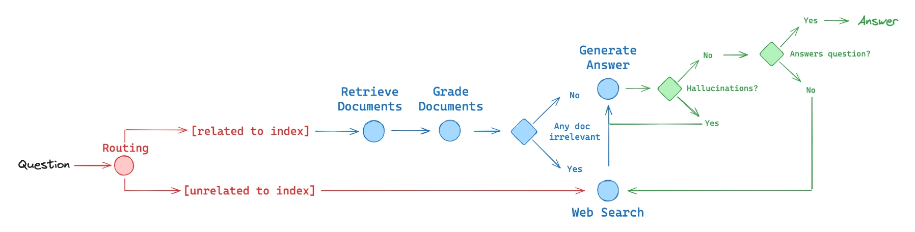
M3: RAG AGENT USING LLAMA-3 (COMBINED APPROACH)
Combines three different RAG approaches: Adaptive RAG, Corrective RAG, and Self-Reflective RAG, leveraging LangGraph, LlaMa-3, and TavilyAPI for optimized web search.
Innovation & Improvement: Auto-corrected answers and reduced hallucinations.
referred 3 arXiv papers

Slide 23
M3: RAG AGENT USING LLAMA-3 (COMBINED APPROACH)
Approach
Adaptive RAG: Analyzes query complexity and routes prompts appropriately to different retrieval approaches (Vector-Store or Web Search), ensuring efficient and accurate responses.
Corrective RAG: Employs a lightweight retrieval evaluator to assess the relevance of retrieved documents, triggering corrective actions to enhance accuracy and relevance - Fallback to web search if irrelevant docs.
Self-Reflective RAG: Introduces a self-reflection mechanism where the model decides whether to retrieve information based on query context and initial responses, allowing for selective and efficient use of external data - Fix answers with hallucinations or don’t address question.
Key Features
Efficient Prompt Routing, Improved Response/Retrieval Quality, Handling of Hallucinations, Evaluation Cost Optimisation, Groundedness

Slide 24
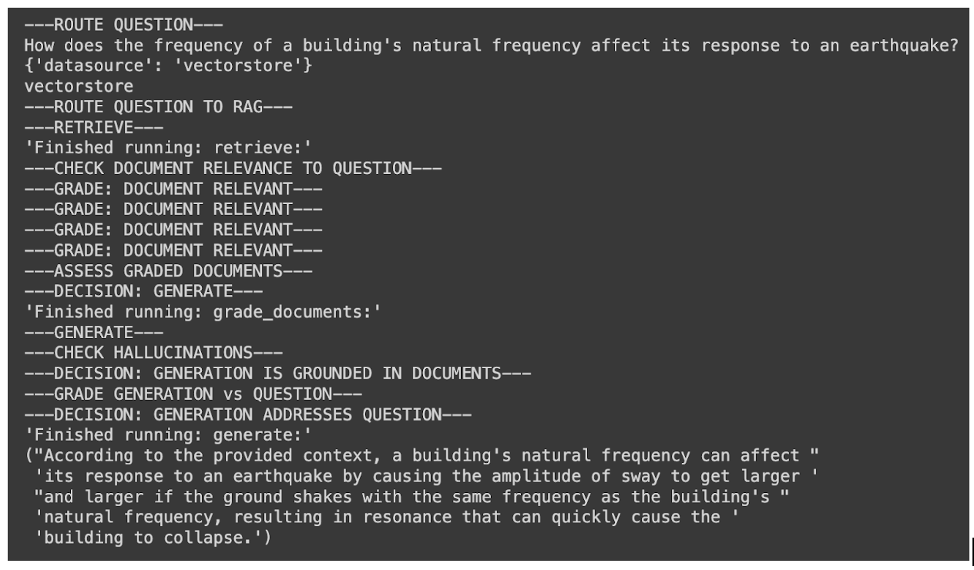
LOCAL RAG AGENT WITH LLAMA3
QUERY ROUTED TO VECTOR STORE

Slide 25
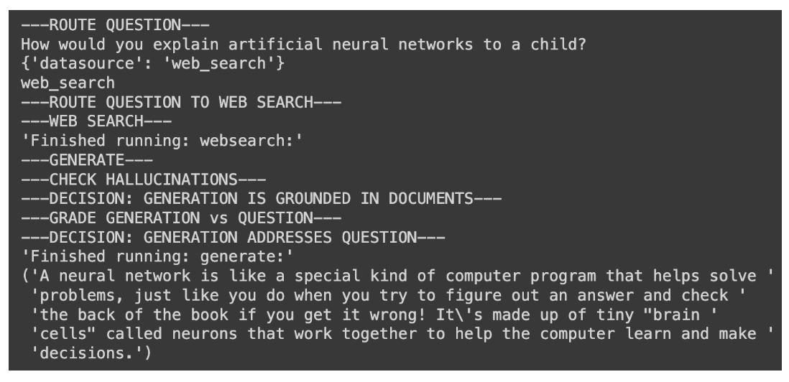
LOCAL RAG AGENT WITH LLAMA3
QUERY ROUTED TO WEB SEARCH

Slide 26
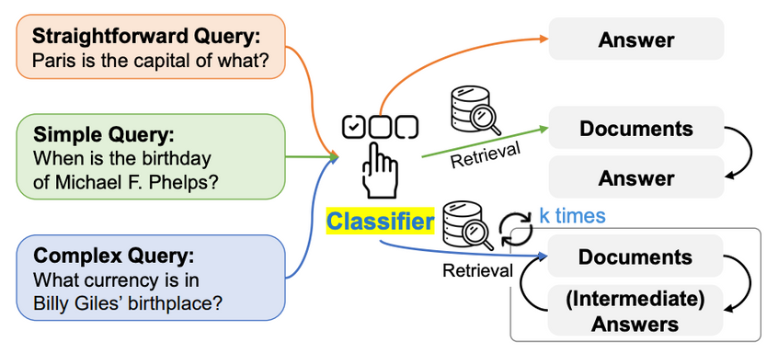
M4: ADAPTIVE RAG WITH ROUTING
Introduction
Utilizes advanced query classification and retrieval to provide accurate and context-rich responses.
Dynamically adapts to the complexity of user queries, ensuring relevance in research and academic domains.
Integrates real-time web search to deliver the most current and comprehensive information.
Approach
Web Search Integration: Uses Wikipedia.
Innovation - Knowledge Graph: Extracts entities, relationships, and relevant information to construct a knowledge graph, enabling structured querying and context-rich retrieval.
Adaptive RAG (Improvement)
Step 1: Retrieve relevant documents from the main vector database (FAISS) using embeddings.
Step 2: Fallback Mechanism, uses a real-time web search with a Wikipedia Search API.
Binary Score Generation: Use a binary score to indicate the document's relevance.

Slide 27
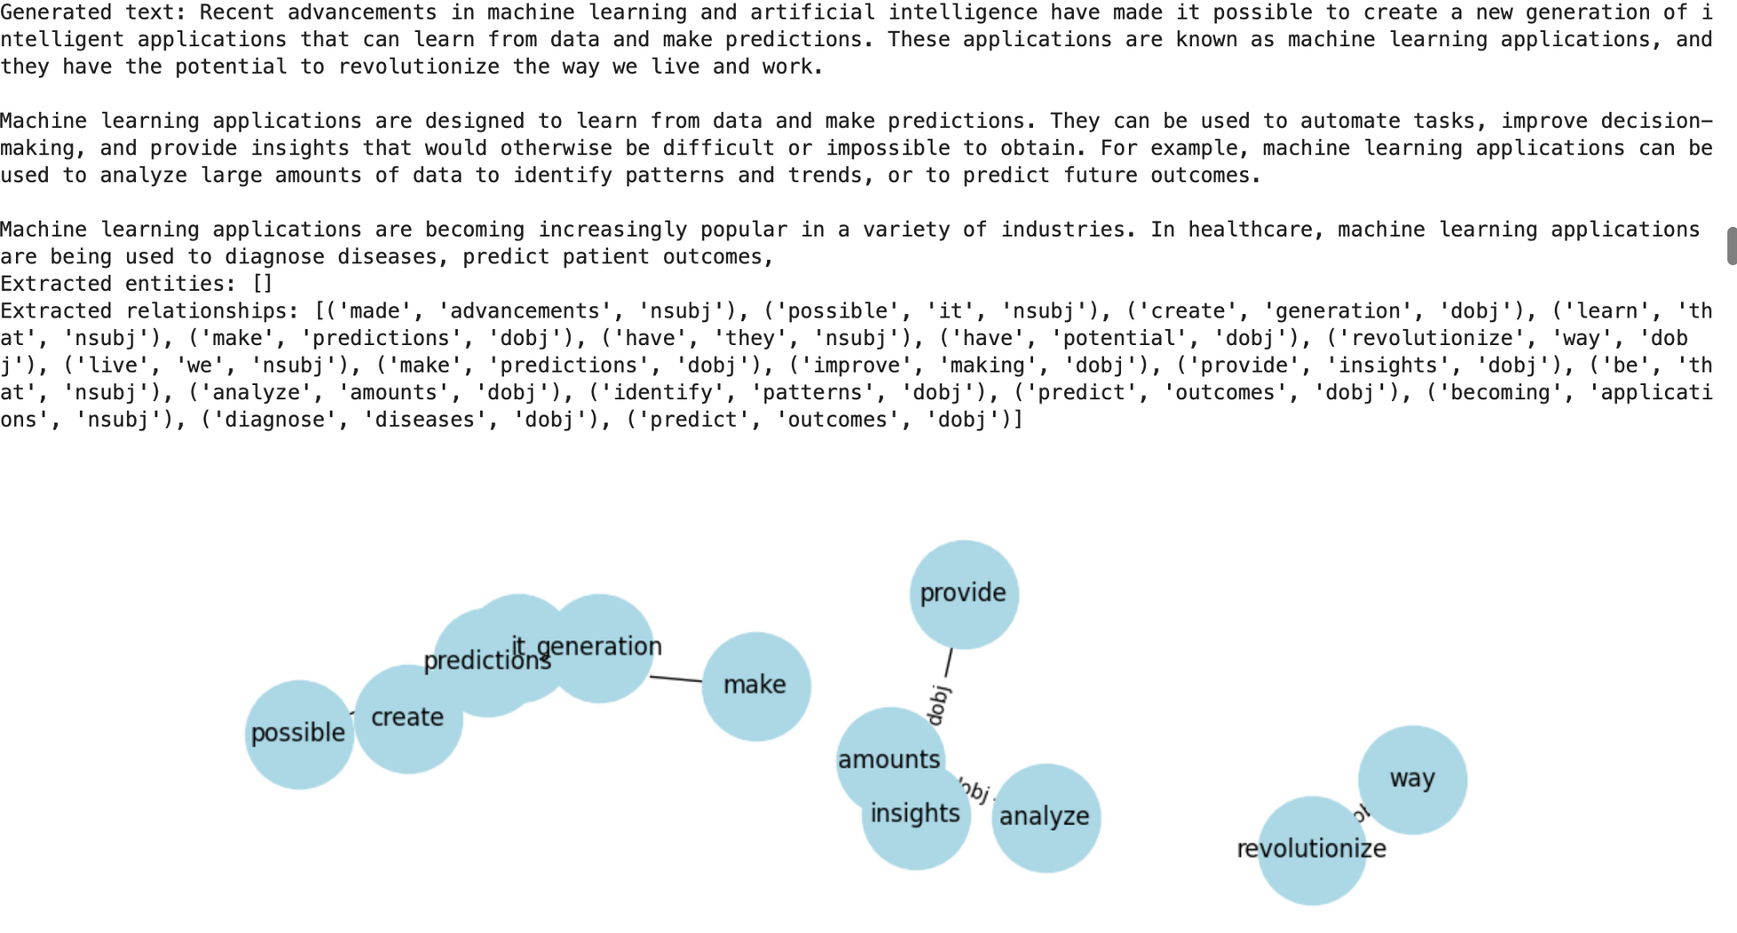
ADAPTIVE RAG WITH ROUTING
GENERATED TEXT WITH A KNOWLEDGE GRAPH FROM THE VECTOR STORE

Slide 28
ADAPTIVE RAG WITH ROUTING
QUERY ROUTED TO WIKIPEDIA SEARCH AND BINARY SCORE FOR RELEVANCE

Slide 29
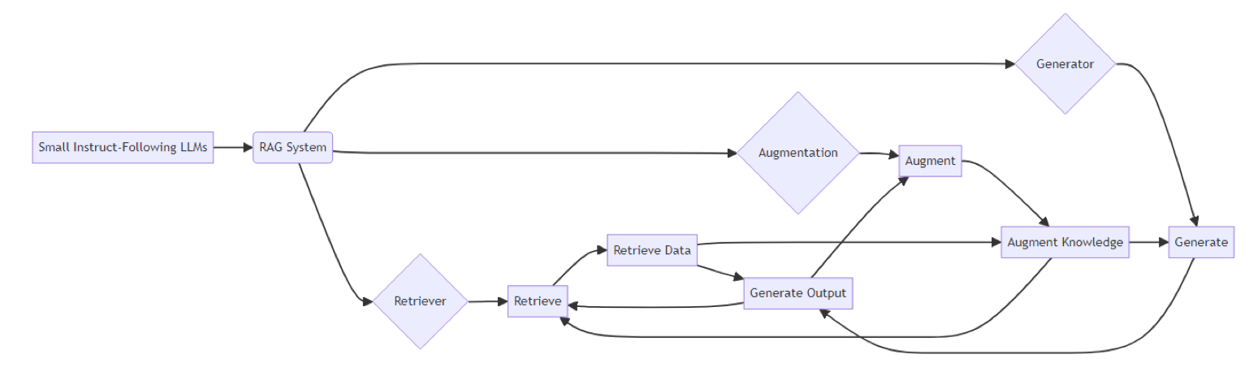
M5: SUPER RAG - DYNAMIC
KNOWLEDGE INTEGRATION
Innovation and Improvement
Enhancement of LLMs by integrating external
knowledge sources.
Aims to improve accuracy, speed, and user satisfaction with minimal structural changes.
Approach
Transforms queries into embeddings to match with relevant external knowledge.
Determines the best response based on the context & reranked and augmented results for accurate response generation.
Key Features
Leverages large-scale web searches to augment the pool of retrievable knowledge.
Expanding the breadth of information accessible.
CacheTuning & Forking to streamline the retrieval process efficiently and enhance speed.
April 13th, 2024
(arXiv paper)

Slide 30
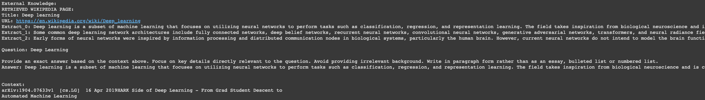
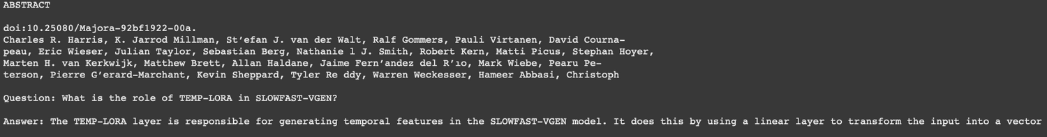
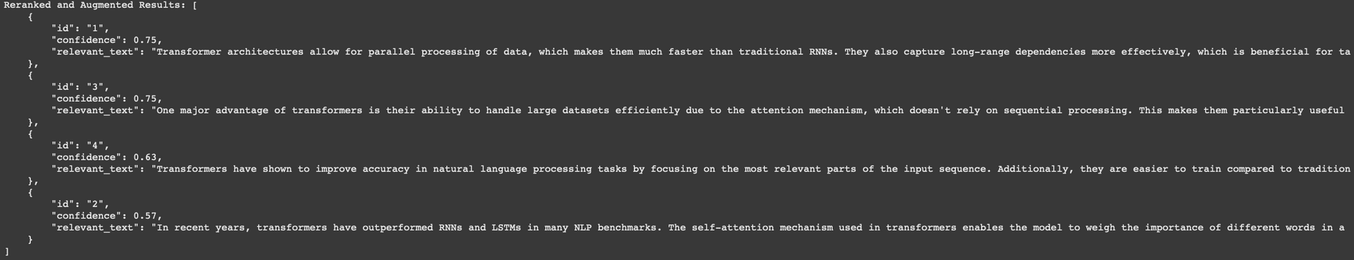
SUPER RAG - DYNAMIC
KNOWLEDGE INTEGRATION
External Knowledge Retrieval
Abstract Summary
Reranked and Augmented Results ordered by confidence

Slide 31
MODEL COMPARISON
Model | Key Features | Approach | Strengths
M1: LLAMA 2 with Ensemble Retrieval | - Ensemble Retriever combining semantic and keyword search - Uses 'thenlper/gte-large' model for embeddings | - PyPDFLoader for PDF processing RecursiveCharacterTextSplitter for chunking - Chroma Vector Store for storage | - Enhanced retrieval techniques - Optimized relevance and coverage
M2: Multi-Modal RAG | - Leverages textual and visual data - Visual captioning with Llama3 | - Uses Hugging Face embedding and pytesseract, Combines textual and visual data for response generation | - Enhanced understanding of visual data - Comprehensive information retrieval
M3: RAG Agent using LLAMA-3 | - Combines Adaptive, Corrective, and Self-Reflective RAG - Uses LangGraph, LlaMa-3, and Tavily | - Analyzes query complexity for routing- Employs retrieval evaluator- Introduces self-reflection mechanism | - Efficient prompt routing - Improved response quality - Handles hallucinations
M4: Adaptive RAG with Routing | - Advanced query classification and retrieval - Integrates real-time web search | - Uses FAISS vector database - Fallback to Wikipedia Search API - Binary score for document relevance | - Dynamic adaptation to query complexity - Provides current and comprehensive information
M5: Super RAG | - Dynamic knowledge integration- SMoE Integration - CacheTuning Forking | - Determines best knowledge source - Directs queries to optimal instruct models | - Efficient input processing - Expanded breadth of accessible information

Slide 32
MODEL EVALUATION RESULTS AND COMPARISON

Slide 33
MODEL EVALUATION METHODS
Automatic Metrics Framework (RAG-Triad Metrics)
Context Relevance: Measures the relevance of the retrieved context to the user's query. Higher values indicate greater relevance.
Answer Relevance: Assesses the pertinence of generated answers to the original prompt.
Groundedness: Evaluates if the response can be traced back to evidence within the source materials.
Answer Correctness: Comparison between Ground truth and Generated Answer
Human Evaluation
Involves evaluator to gauge naturalness, coherence, and the success rate of task completion.
Threshold Adjustment
Establishes a benchmark for cosine similarity to determine the correctness of answers against a ground truth reference.
Master LLMs and Autoraters
Utilized for detailed assessments of response accuracy, completeness, and appropriateness based on pre-trained criteria.
Response Time
Captures time from query initiation to response reception. Iterative improvements made.
Resource Utilization
Monitor CPU, GPU, and memory usage

Slide 34
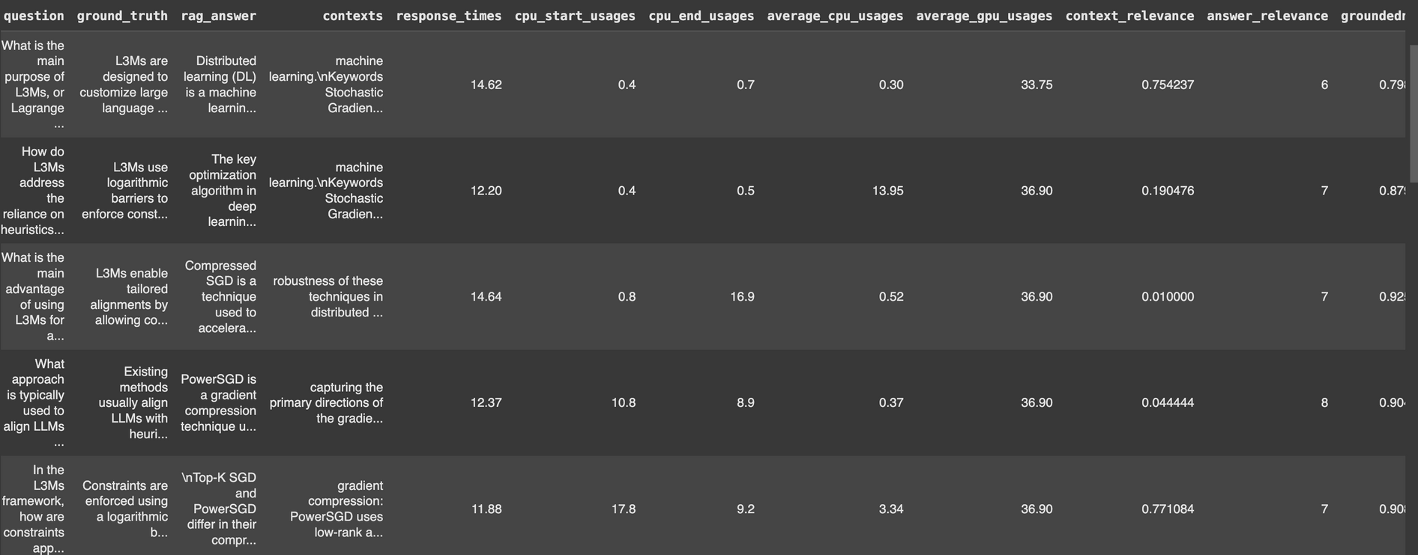
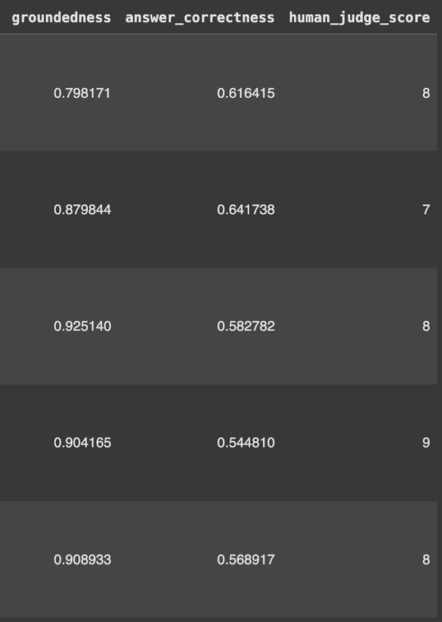
SAMPLE METRICS FILE

Slide 35
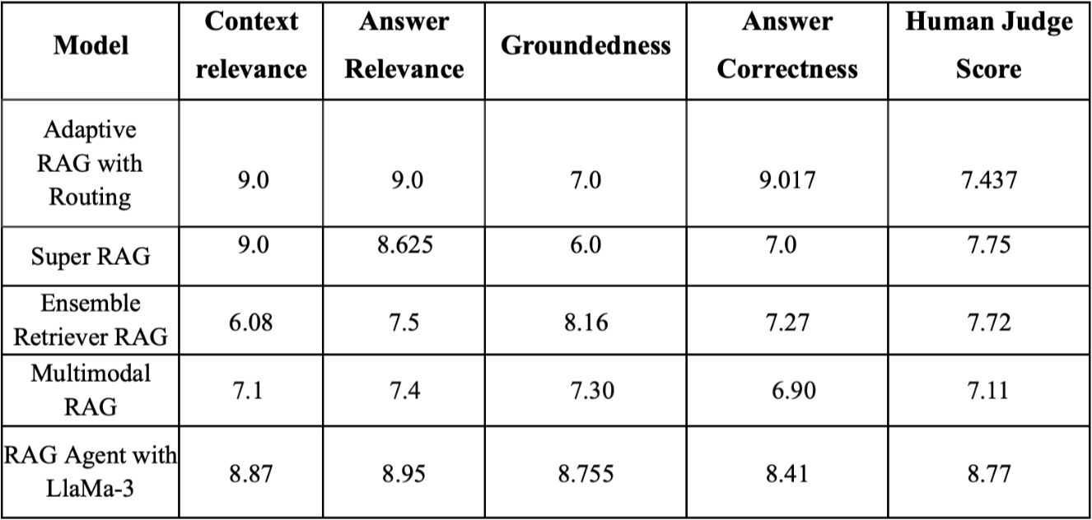
​​​​M1: LLAMA-7B WITH ENSEMBLE RETRIEVAL FOR HYBRID RAG FRAMEWORK (BASE MODEL)
OVERALL CORRECTNESS
Best Context Relevance - Adaptive RAG and Super RAG
Best Answer Relevance - Adaptive RAG and RAG agent with Combined Approach
Best Answer Correctness - Adaptive RAG and RAG agent with Combined Approach
Best Judge Scores - RAG agent with Combined Approach and Super RAG

Slide 36
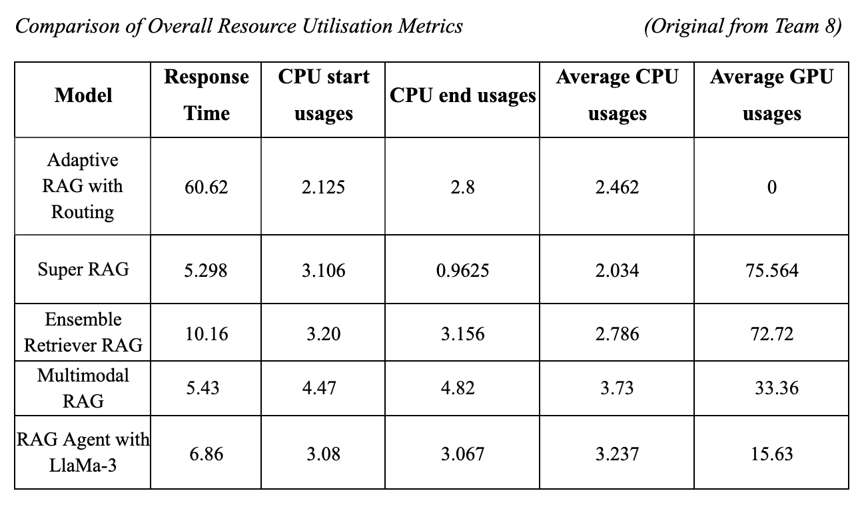
​​​​M1: LLAMA-7B WITH ENSEMBLE RETRIEVAL FOR HYBRID RAG FRAMEWORK (BASE MODEL)
RESOURCE UTILISATION METRICS
Best Response Time - Multimodal RAG
GPU Usage - RAG Agent with Combined Approaches

Slide 37
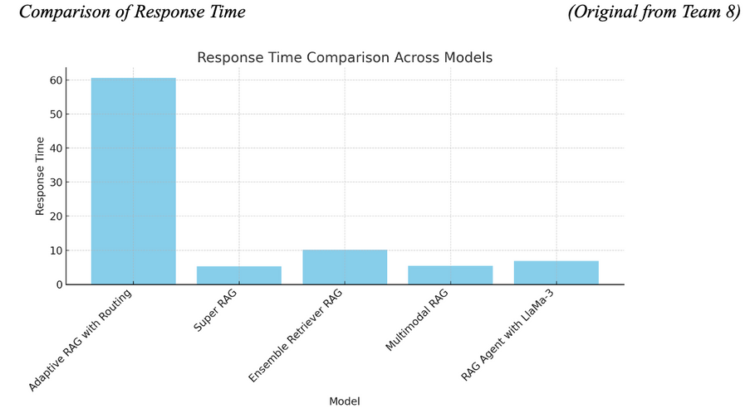
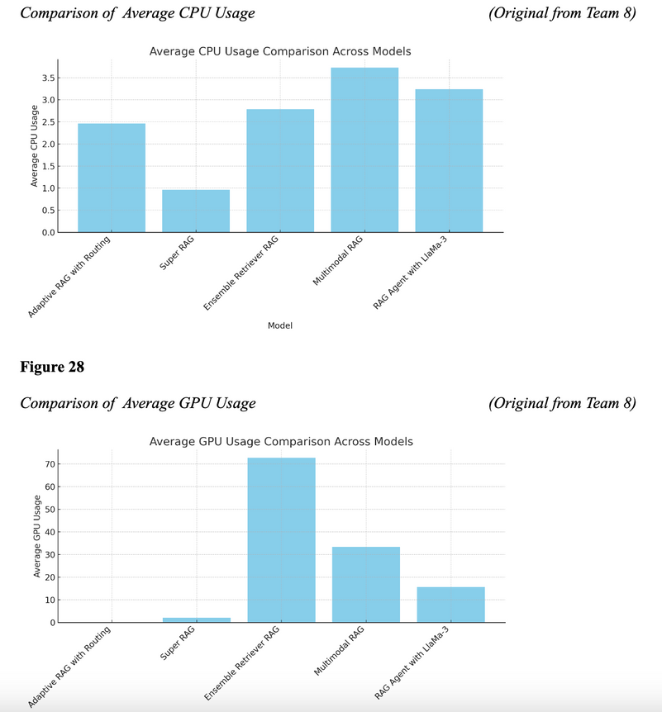
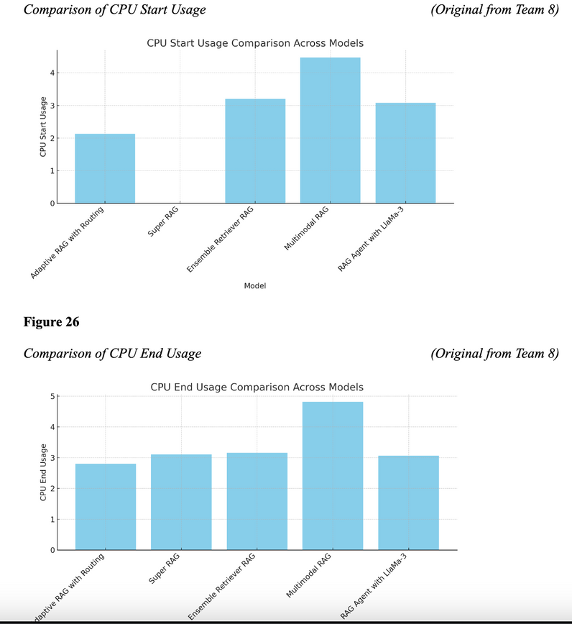
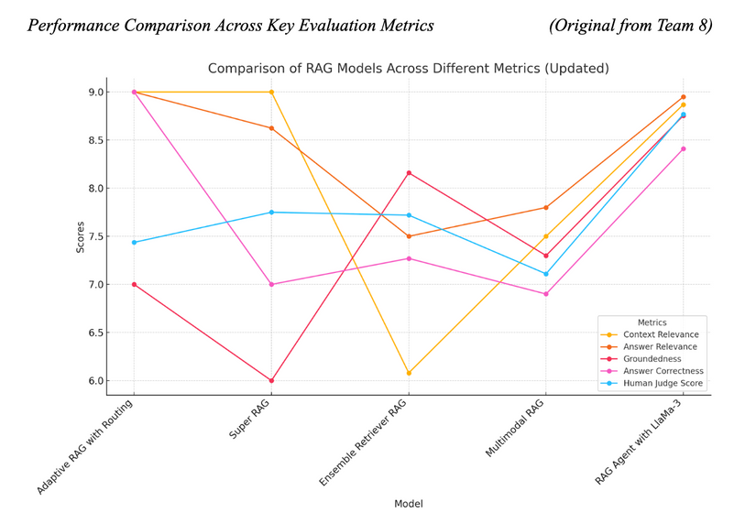

Slide 38
WEB-BASED SYSTEM DESIGN AND UI

Slide 39
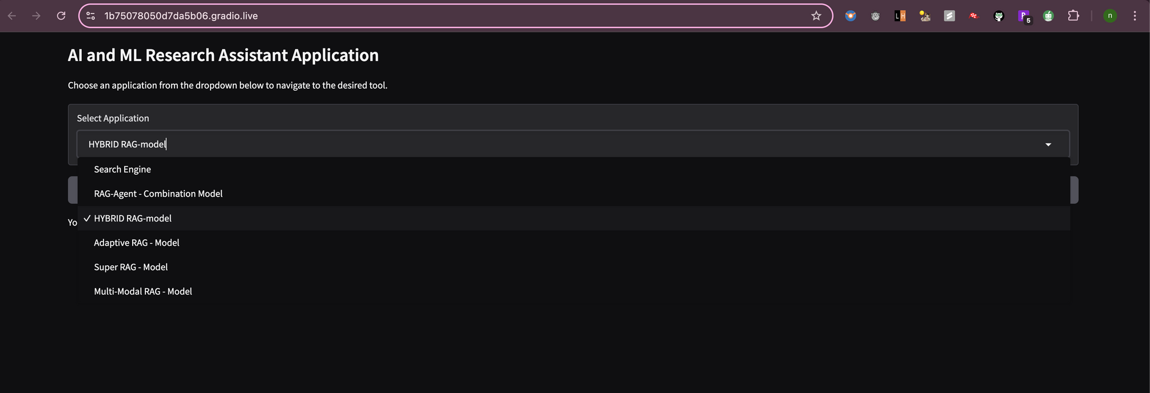
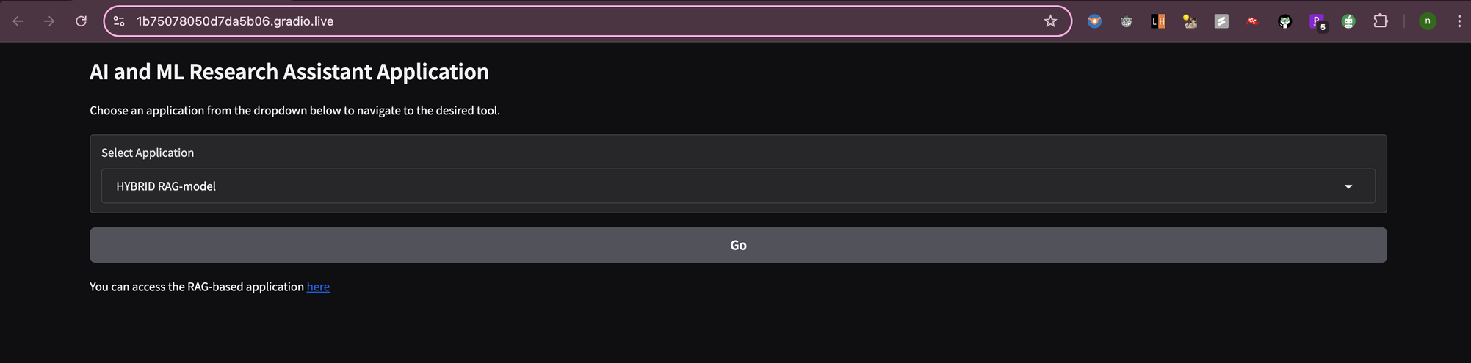
HOME PAGE USER INTERFACE (LANDING PAGE)

Slide 40
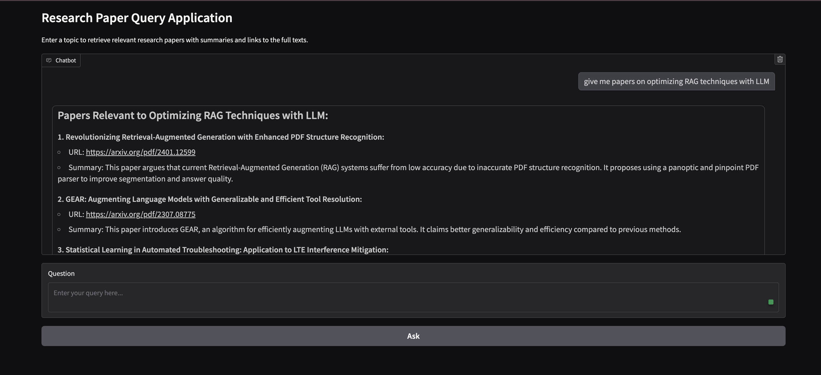
RESEARCH PAPER SEARCH ENGINE

Slide 41
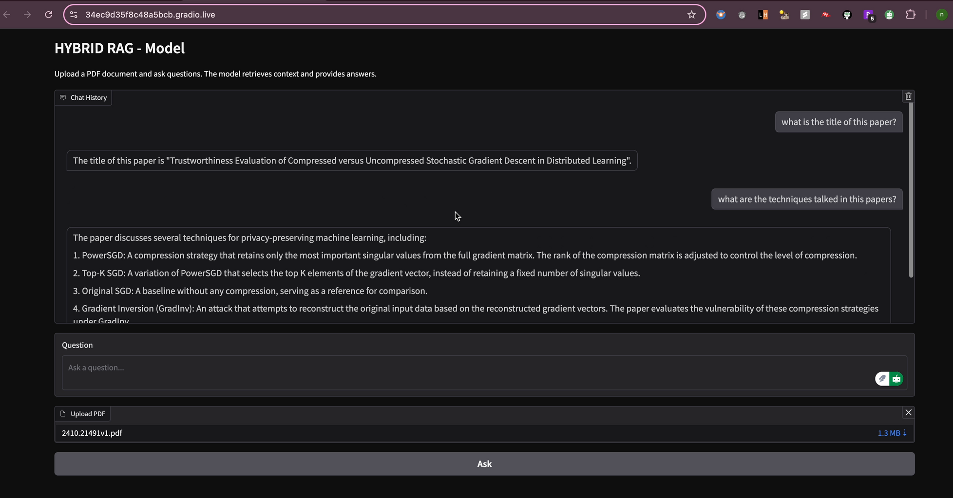
​​​​M1: LLAMA-7B WITH ENSEMBLE RETRIEVAL FOR HYBRID RAG FRAMEWORK (BASE MODEL)

Slide 42
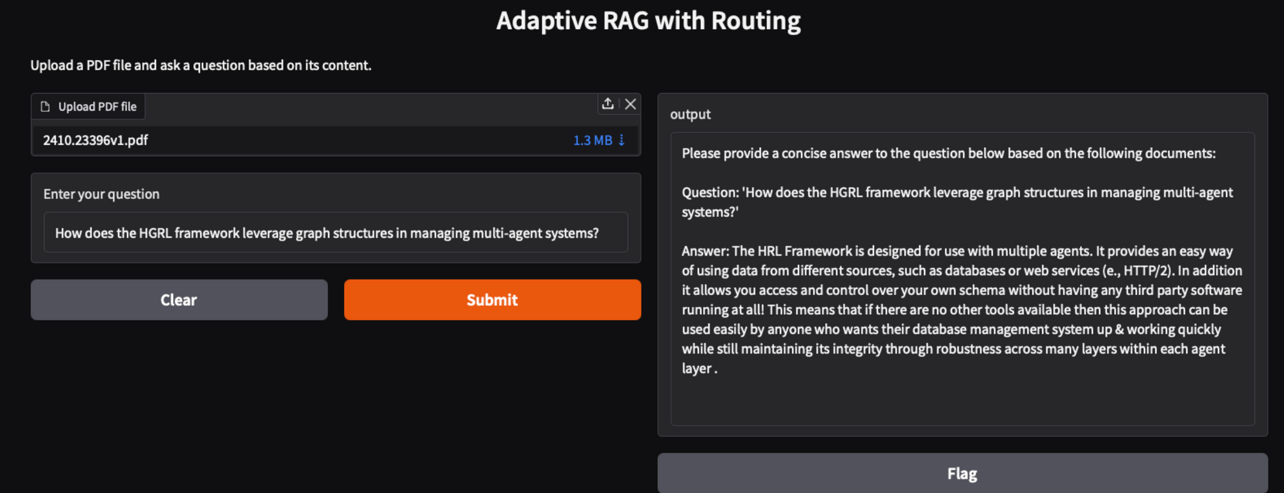
​​​​M2: ADAPTIVE RAG WITH ROUTING

Slide 43
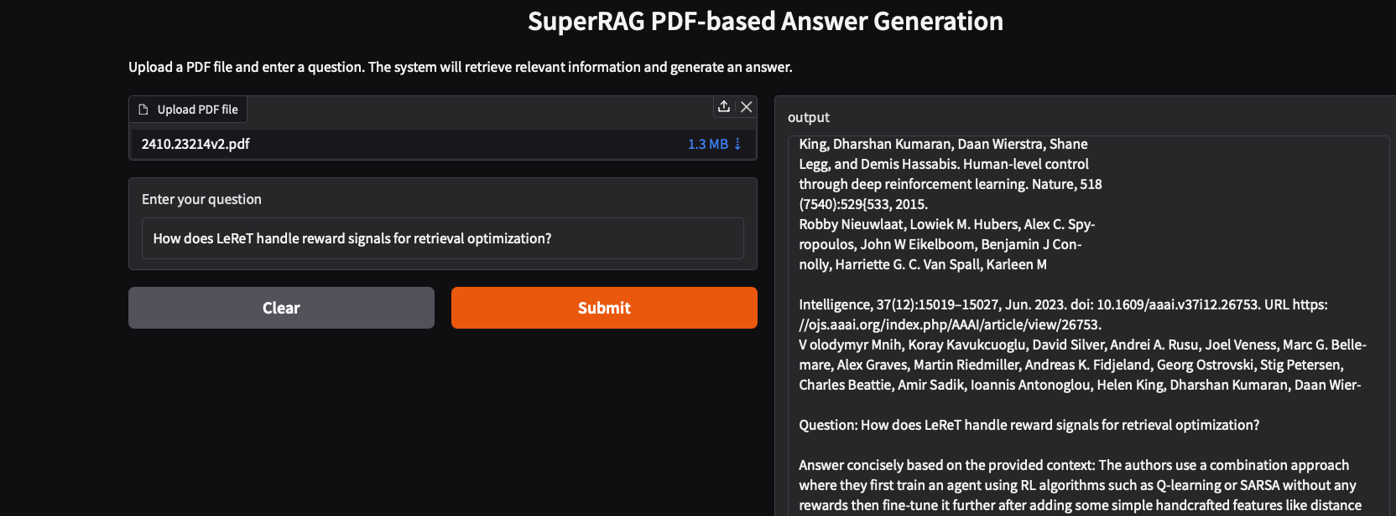
M3: SUPERRAG WITH DYNAMIC KNOWLEDGE INTEGERATION

Slide 44
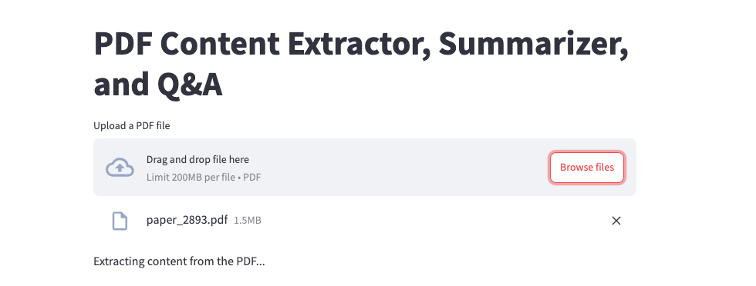
M4: MultiModal RAG

Slide 45
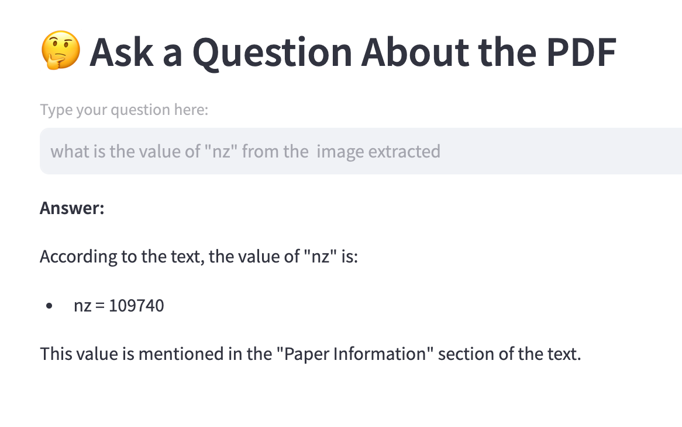
MultiModal RAG

Slide 46
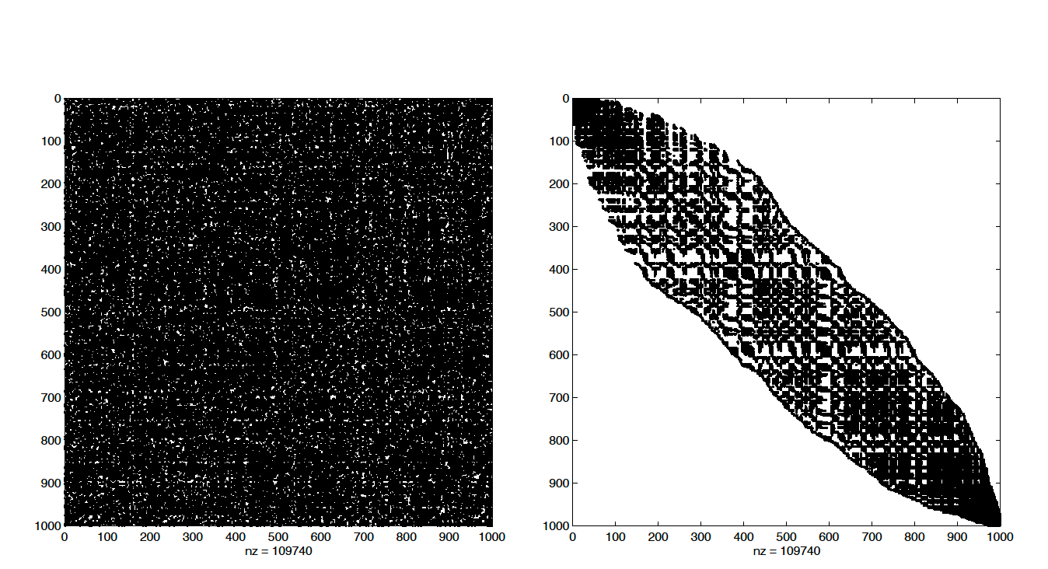
A Snippet from the PDF (For Reference)

Slide 47
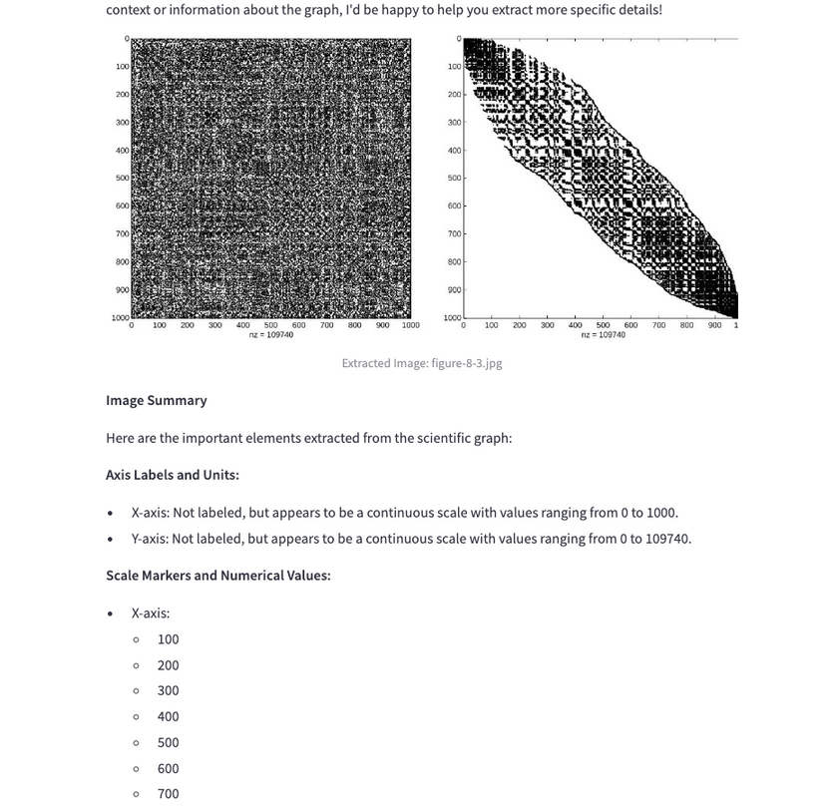
Image Extraction

Slide 48
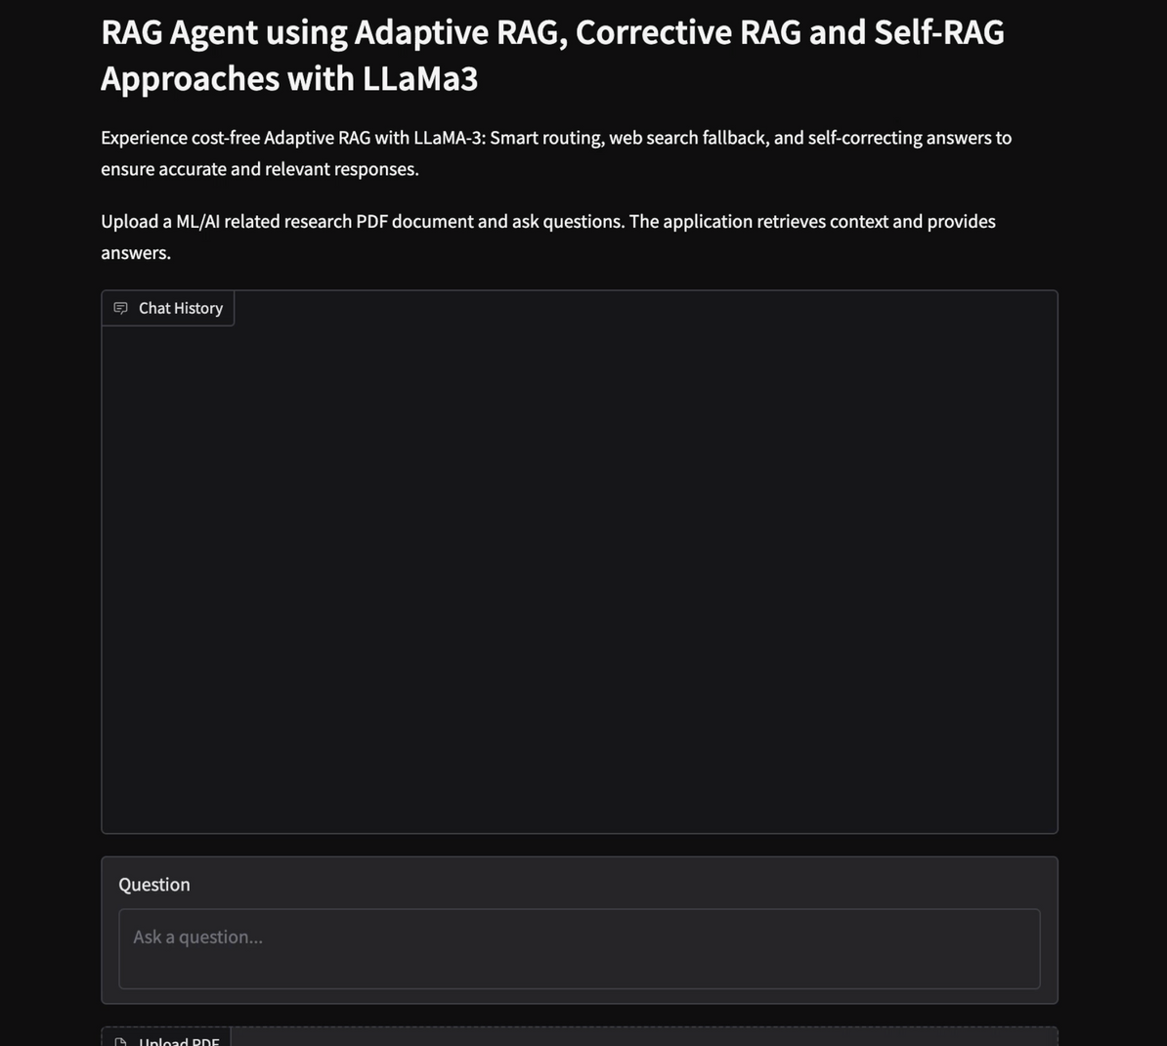
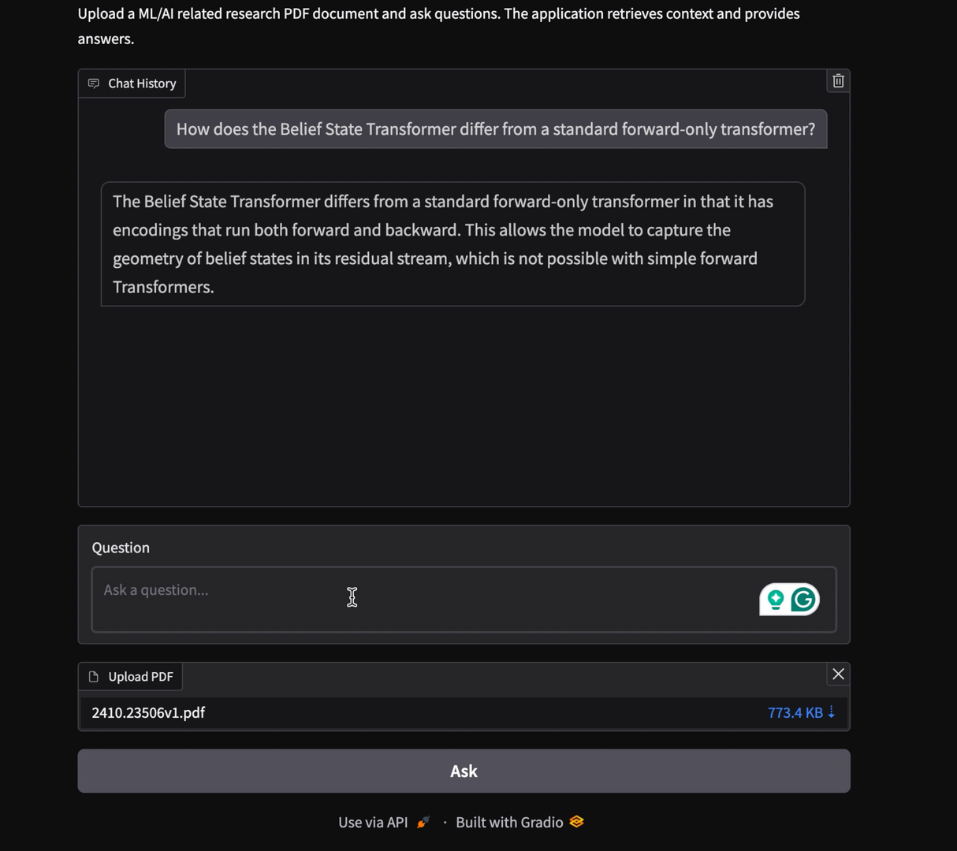
M5: LOCAL RAG AGENT WITH LLAMA3 - ADAPTIVE, CORRECTIVE & SELF-REFLECTIVE RAG APPROACHES

Slide 49
SYSTEM DEMO & TESTING

